Slide 1
GM BT1CG HL Light Block 1052
Incoming Inspection Report
06/05/2023
Juarez Chihuahua.

Slide 2
Index
Tool General Information Identification Plaques.
Injection layout – Hot Runner System ,Plaques, tests .
Layout Cavity Side (Main appearances ).
Slides , Retractors , Lifters Details.
Layout Core Side (Main appearances ) .
Ejector System & Parts .
Locating Ring.
Electrical Plugs .
Water Leaks Test.
Spare Parts , Documents ,Tool manuals etc. Received .
Observations / Summary.
Quick Check List.

Slide 3
Tool General Information Identification Plaques
01

Slide 4
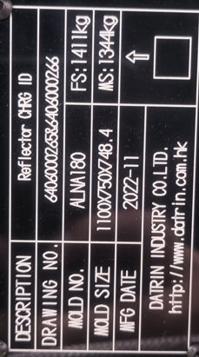
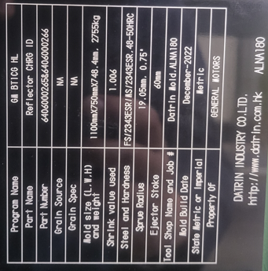
Tool Identification plate
✓
Tool Identification | Description
Owner of Tool: | GMC
Tool Source: | Datrin Mold
Job: | ALNA 180
Part Number: | 6406000265/ 6406000266
ASSET#
ALNA Number: | ALNA 180
BACK TO INDEX

Slide 5
Tool Identification plate
✓
Tool Description
mold weight: | 2,755 kg
mold size (axbxc): | 1100mm x 750mm x 748.4mm
Texture Type: | No
Core Steel Type: | FS/2343ESR/MS/2343ESR, 48-50HRC
Cavity Steel Type: | FS/2343ESR/MS/2343ESR, 46-49HRC
Sprue Radius: | SR 19.05m
Orifice Size: | D .75 mm

Slide 6
Injection layout – Hot Runner System ,Plaques, tests .
02

Slide 7
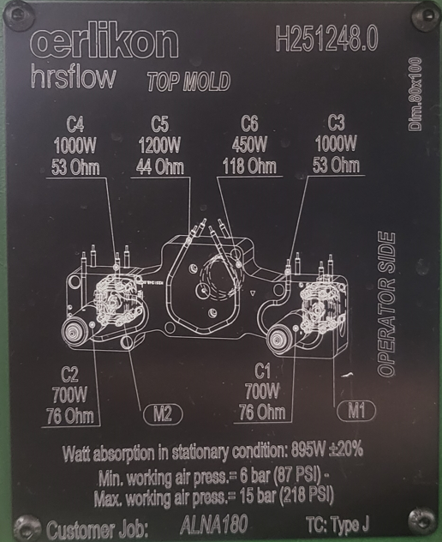
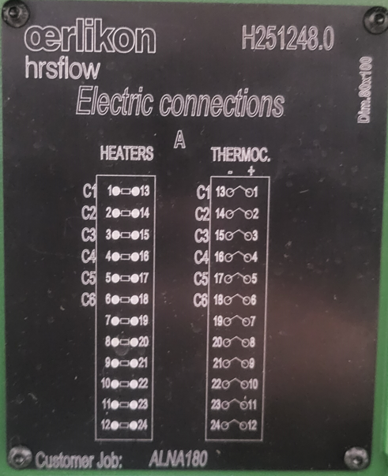
Hot Runner System
✓
Zone Hot Nozzle system:
# Zones 6
Hot Runner System OERLIKON #H251248.0

Slide 8
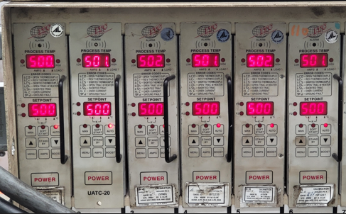
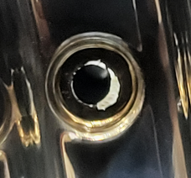
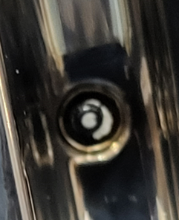
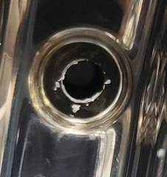
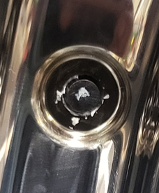
Hot Runner System Testing
✓
Valve #1open
Valve #1 Closed
Valve #2 open
Valve # 2 Closed
Heaters tested at 500 ° C, valve pin movement is performed, ok they open and close correctly.
Testing the hot runner system comments:

Slide 9
Layout Cavity Side (Main appearances )
03

Slide 10
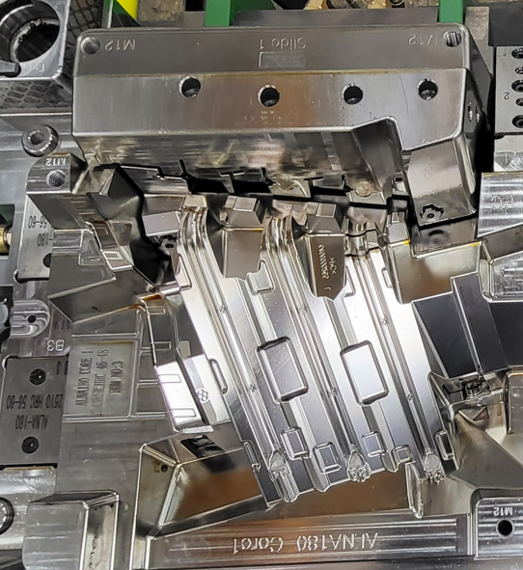
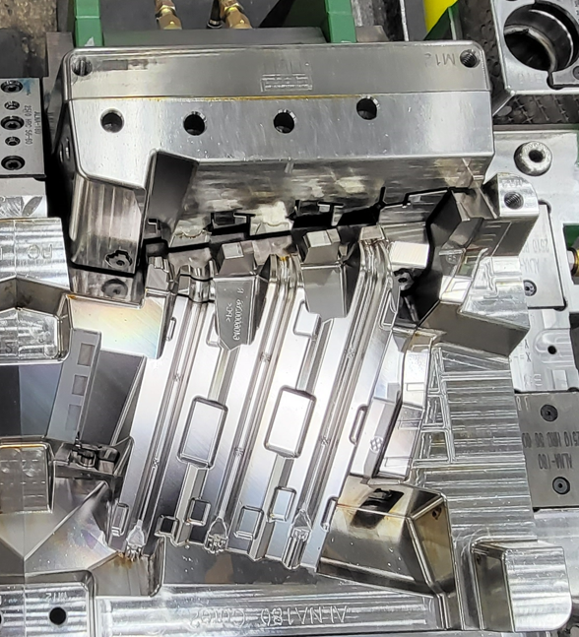
Lay outs – Mobile Side
✓
Sectional views:
1
2

Slide 11
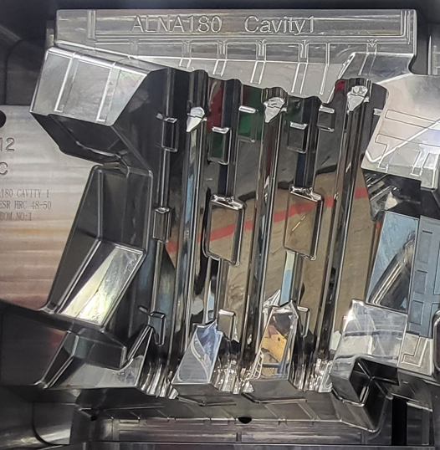
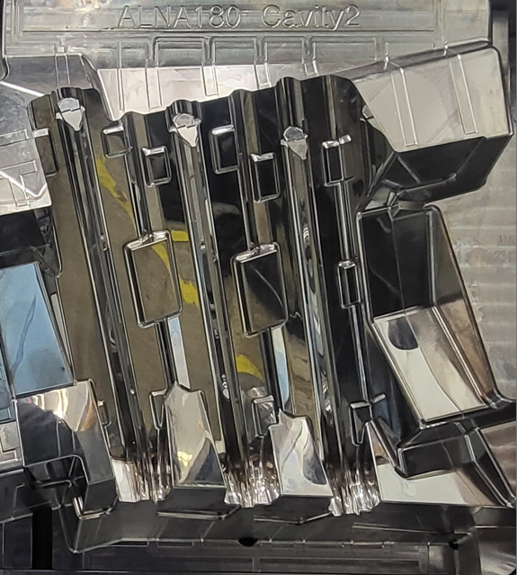
Lay outs – Fixed Side
Sectional views:
✓
1
2
The mold has mirror in all cavities

Slide 12
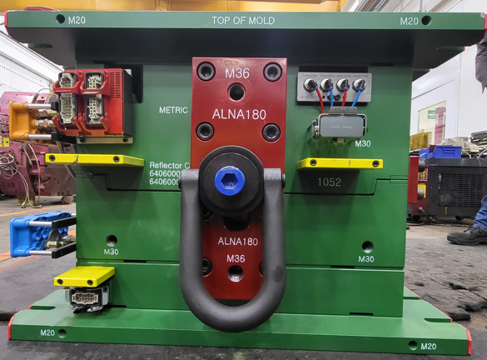
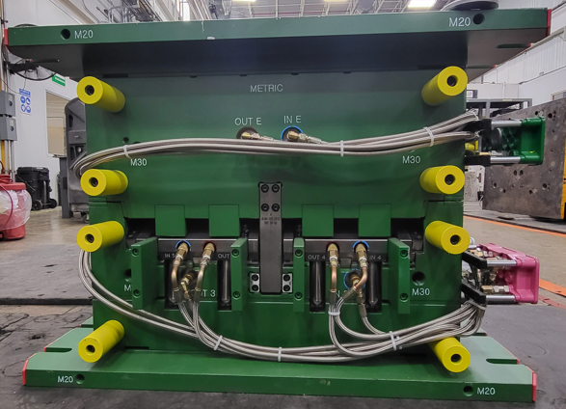
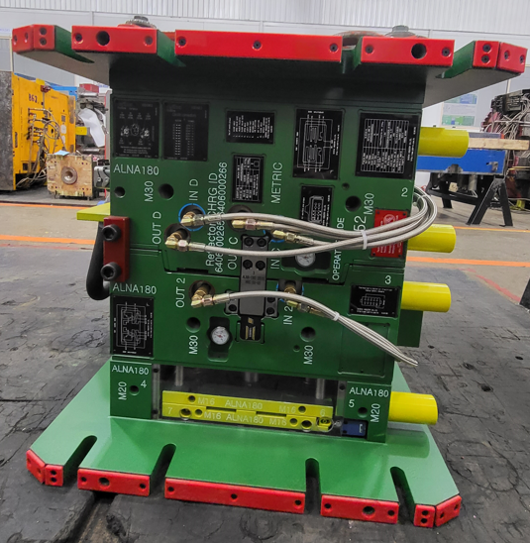
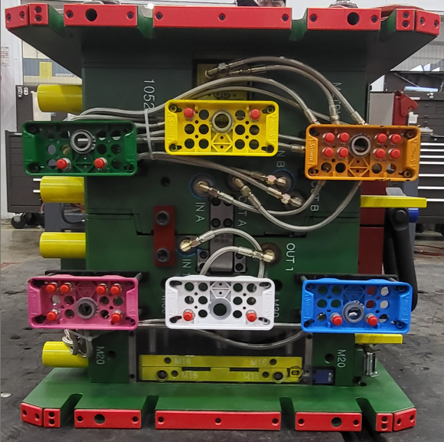
Tool View
✓
Top Side
Bottom Side
Non Operator Side
Operator Side

Slide 13
Slides , Retractors , Lifters Details.
04

Slide 14
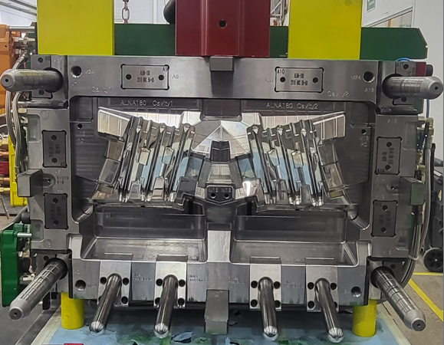
Lay outs – Fixed Side
Mold Cavity- how many cavity
✓
Identification of Mechanisms by Colors
Sliders
Lifters
Recuperators
Leader Pin
Angle pin
Spotting Plaques

Slide 15
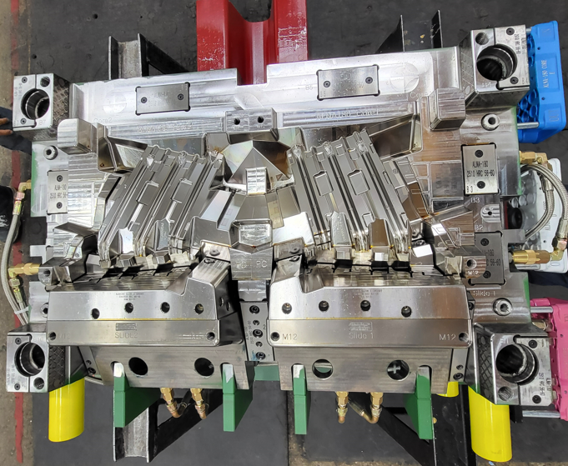
Lay outs – Mobile Side
Mold Cavity- how many cavity 2
✓
Identification of Mechanisms by Colors
Sliders
Lifters
Recuperators
Leader Pin
Greasers
Spotting Plaques

Slide 16
Slides, Retractors , Lifters etc.
✓
Mold Have The Following Systems.
Components | Lifters | Recuperators | Sliders | Ejector Sleeves | Ejector Blades | Ejector Pins | Others
Quantity | NO | 4 | N/A | N/A | N/A | 28
Damages | NO | NO | N/A | N/A | N/A | NO
Water Cooling? | NO | NO | N/A | N/A | N/A | N/A
Plugs: Press Fit Or Threaded | N/A | N/A | N/A | N/A | N/A | N/A
Water Leaks | N0 | N/A | N/A | N/A | N/A | N/A
Water Connectors Size | NO | N/A | N/A | N/A | N/A | N/A
Welding Marks | NO | NO | N/A | N/A | N/A | NO
Movements | NO | NO | N/A | N/A | N/A | YES
Fastening With Screws Or Bolts | NO | N/A | N/A | N/A | N/A | N/A
Stopper | N0 | N/A | N/A | N/A | N/A | N/A
CAM PIN Position | N/A | N/A | N/A | N/A | N/A | N/A
Slide Retainer | N/A | N/A | N/A | N/A | N/A | N/A
ALNA Standard? | N/A | N/A | N/A | N/A | N/A | YES
Additional Comments:

Slide 17
Layout Core Side (Main appearances )
05

Slide 18
Layout Core Side (main appearences)
✓
It has no hydraulic system

Slide 19
Ejector System & Parts .
05

Slide 20
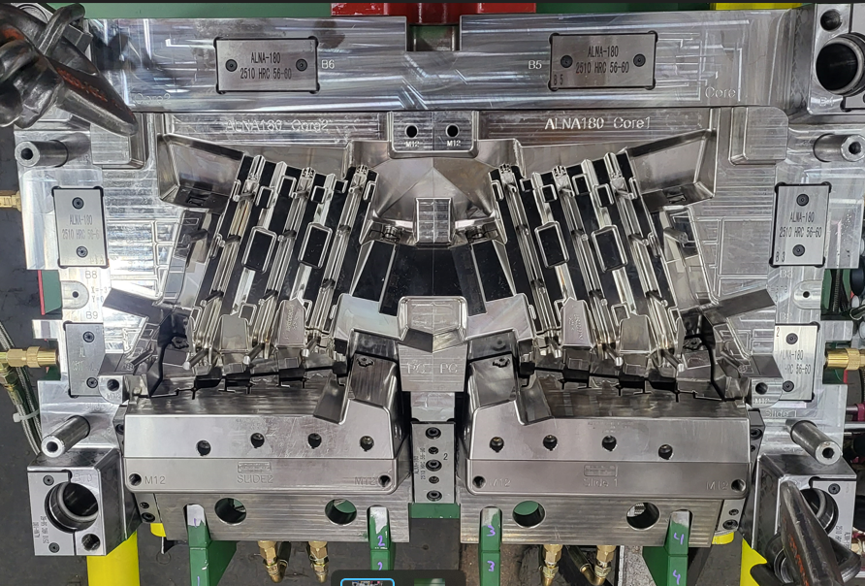
Ejector System
✓
First position: Slides & retractors in Position backward
Second position: Slides & retractors in Position forward ( ejection backward)

Slide 21
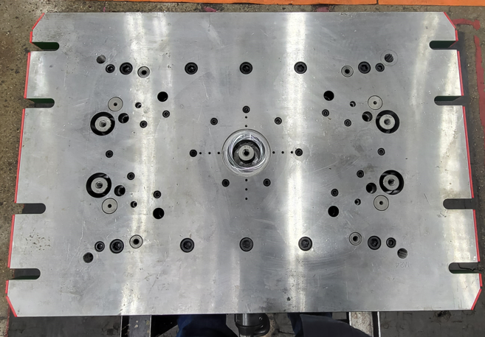
Ejector System
✓
Ejection System Has The Following Configuration:
hydraulic ejection system
blow ejection system
1050mm

Slide 22
2 PERNOS EXPULSORES | D=10mm x L=310mm
8 PERNOS EXPULSORES | D=8mm x L=350mm
18 PERNOS EXPULSORES | D=6mm x L=330mm
4 RESORTES AZULES | D.Ext= 39.7mm D.int=20mm x L=175mm
4 RESORTES AZULES | D.Ext= 20mm D.int=10mm x L=25mm
4 SHOULDER | D=40mm x L=62mm / Rosca 16mm
Ejector System Parts

Slide 23
Locating Ring.
06

Slide 24
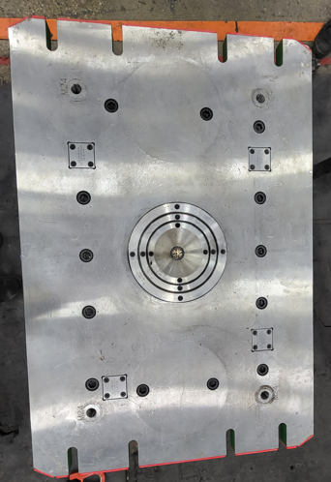
Locator Ring
✓
Fixed Side
Mobile Side
The diameter of the centering rings on the fixed side is 200mm

Slide 25
Electrical Plugs .
07

Slide 26
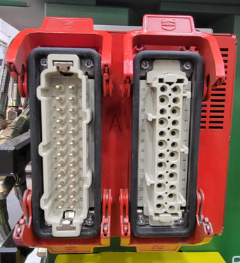
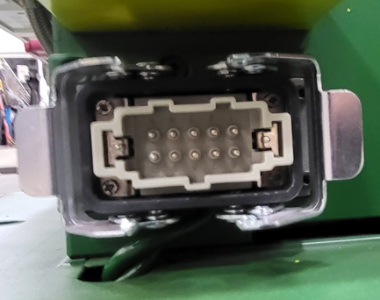
Electrical Parts
✓
Conector Plug for HotRunner System.
Connector standard D-M-E per Heater and Thermocouples
6 for heater and 6 for thermocouples
Connector standard for limit switch D-M-E
Heaters & Thermocouple.
Limit Switch Connector

Slide 27
Water Leaks Test
08

Slide 28
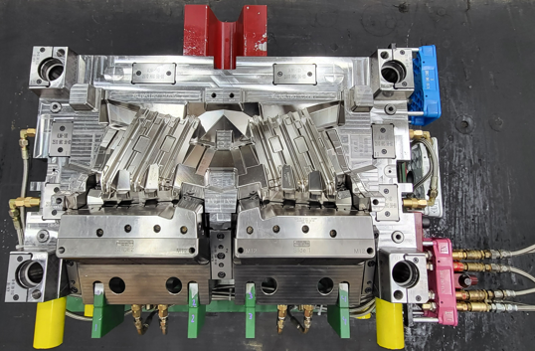
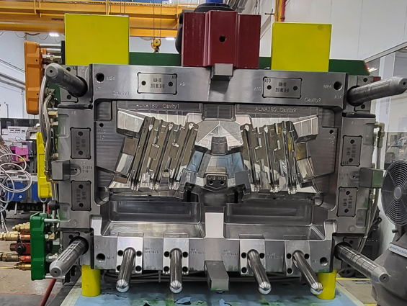
Water Leak Testing
✓
Mobile side
Fixed side
Cooling tests are performed, result ok without water leaks.

Slide 29
Spare Parts , Documents ,Tool manuals etc. Received .
09

Slide 30
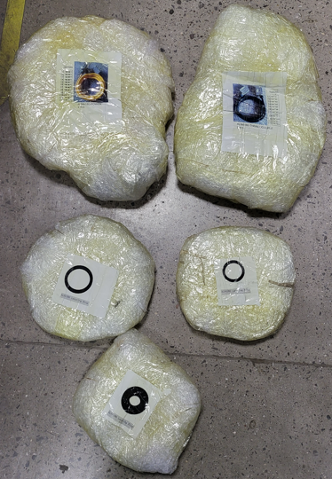
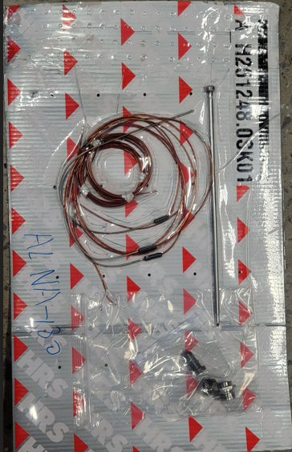
1 | Folder
1 | Usb
1 | Hot System
3 | Centering ring (mobile)
2 | Cables for controller
Spare Parts, Documents, Tool Manual Received.

Slide 31
Observations / Summary.
10

Slide 32
Observations
The Ejector System Is Working. Okay
The Hot System Works Ok
Mirror Areas Okay
Alna Estándar Okay
Coolingsystem core side / cavity side Ok
Texture área: Okay

Slide 33
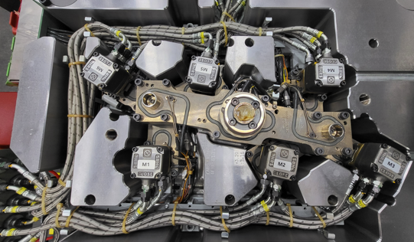
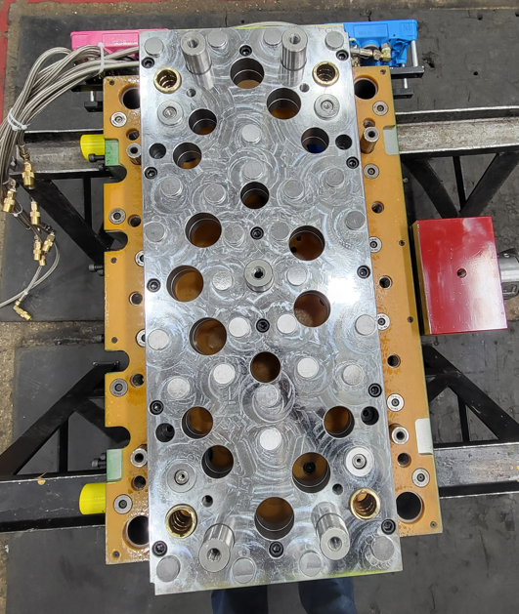
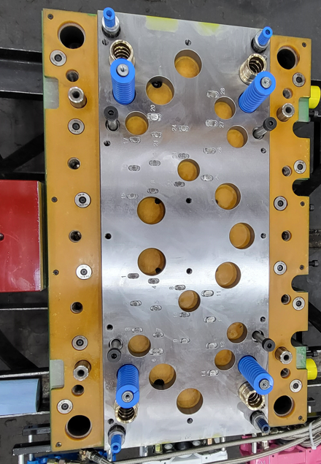
Observations
Revision of hot runner free of plastic material ok
Expulsion System Review

Slide 34
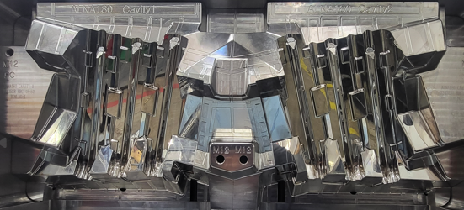
Observations
✓
cavities have a Mirror

Slide 35
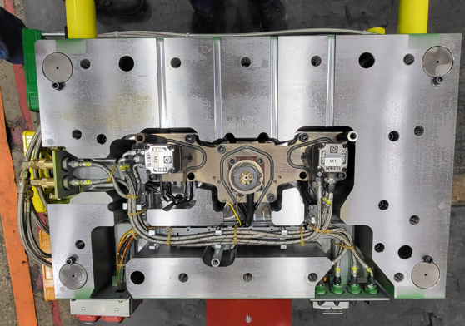
Observations
✓
Hot System OK

Slide 36
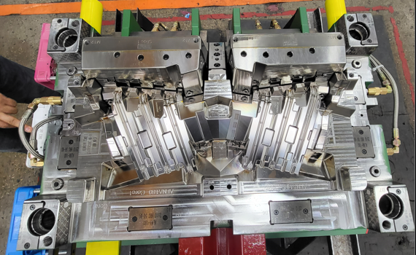
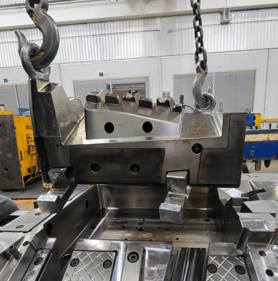
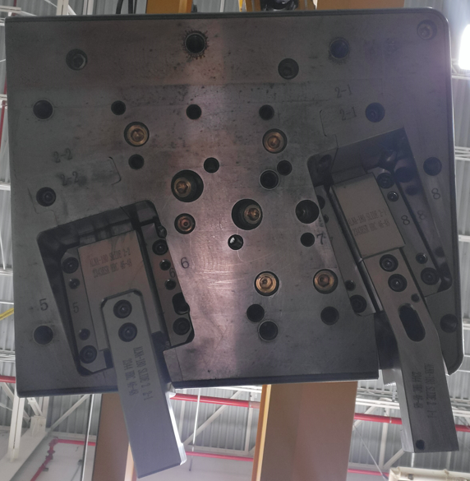
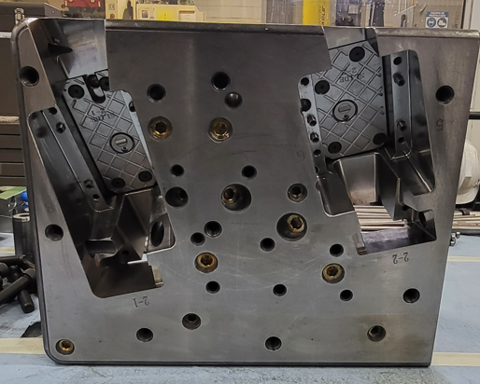
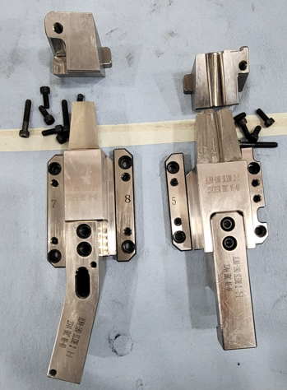
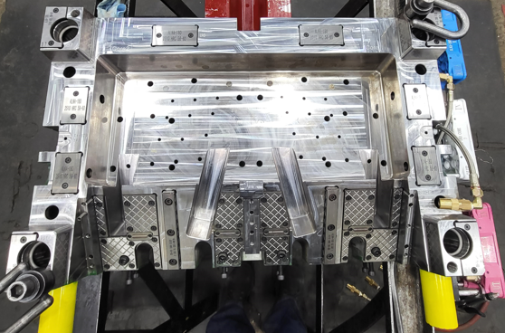
Observations
✓
CORES
To be able to grease the cores it is necessary to remove cavities

Slide 37
Quick Check List.
11

Slide 38
Quick Checklist
L# | DESCRIPTION | YES | NO | N/A | COMMENTS / OBSERVATIONS
1 | LOCATING RINGS | x
2 | AIR VENTS & ITS DEPTH | x
3 | INTERLOCKS ( PARTING LINE LOCKS ) |  | x
4 | DATE INSERTS OR ENGRAVING | x
5 | HOT RUNNER SYSTEMS NUMBER | x |  |  | H251248.0
6 | THERMOCOUPLE & RESISTANCE SPARES | x
7 | EJECTOR BLADES |  | X
8 | VALVE GATES AVAILABILITY | x
9 | ANGLE PINS FOR SLIDES | x
10 | LOCKING CYLINDERS AVAILABILITY | x
11 | SPRINGS ON EJECTION SYSTEM | x
12 | TEXTURES IN CAVITY |  | X
13 | IDENTIFICATION ON ALL PARTS | x
14 | HYDRAULIC PISTON FOR CORES |  | X
15 | LIMIT SWITCHES (MICRO SWITCH) | x
16 | RJG OR SPECIAL SENSORS |  | x
17 | SAFETY LOCK | x
18 | INSERT CHANGES SPARES |  | X
19 | MOLD DRAWINGS & CD | x

Slide 39
Quick Checklist
L# | DESCRIPTION | COMMENTS
1 | MOLD NUMBER | 1052
2 | PART NUMBER | 6406000265 / 6406000266
3 | PART NAME | GM BT1CG HL (REFLECTOR)
4 | NO. OF CAVITIES | 2
5 | CAVITIES MARKED NO.'S | NO
6 | TOOLING ENGINEER NAME | Protev
7 | MOLD ARRIVAL DATE | 26/04/2023
8 | MOLD INCOMING INSP. DATE START | 06/05/2023
9 | MOLD INCOMING INSP. DATE FINISH | 08/05/2023
10 | TOTAL ACCUMULATED HOURS | 15hrs
11 | INCOMING INSPECTION STATUS | FINISHED
12 | INCOMING INSPECTION PERFORMED BY | Alberto Ramirez & Juan Puentes
13 | FREQUENCY FOR PM
14 | PRESS ASSIGNED

Slide 40
Thanks!

